Slide 1
prismo.ai
Statistical Techniques
for
Business Forecasting

Slide 2
CONTENTS – Part I
prismo.ai
SL No. | Topics
1 | Introduction to business forecasting
2 | Regression analysis and forecasting
3 | Exploring time series data
4 | Time series decomposition
5 | Exponential smoothing methods
6 | Autoregressive integrated moving average (ARIMA) models
7 | Intervention models and dynamic regression

Slide 3
prismo.ai
INTRODUCTION
to
BUSINESS FORECASTING

Slide 4
prismo.ai
INTRODUCTION
Forecast
A prediction of some future event or events
Example:
The number of 2-wheeler sales in Bangalore during next month
The average volume of an airline passengers in the next quarter
Field of applications
Business and industry | Medicine
Government | Social science
Economics | Politics
Environmental science | Finance

Slide 5
prismo.ai
INTRODUCTION
Classification of Forecasting problems
Short -term | Involves predicting events only a few time periods (days, weeks, months) into future
Medium - term | Involves predicting events to one or two years into future
Long - term | Involves predicting events to many years into future
Type | Uses
Short –term & Medium-term | budgeting and selecting new research and development projects
Long - term | Strategic planning

Slide 6
prismo.ai
INTRODUCTION
Methodology
Based on identifying, modeling and extrapolating the patterns found in historical data
Historical data usually exhibit inertia and do not change dramatically very quickly
Involves use of statistical methods and time series data
Time series
A time oriented or chronological sequence of observations on a variable or metric of interest
A collection of observations or data made sequentially in time
A dataset consisting of observations arranged in chronological order
A sequence of observations over time

Slide 7
prismo.ai
INTRODUCTION
Applications
Operations Management: Forecasting of product sales or demand for services in order to schedule production, control inventories, manage supply chain, determine staffing or resource requirements and plan capacity
Marketing: Forecasting of sales response to advertising expenditures, new promotions or change in pricing policies to evaluate their effectiveness, determine whether goals are being met and make adjustments
Finance and Risk Management: Forecasting of the return on investments (on financial assets like stocks, bonds, commodities, etc), interest rates, options and currency exchange rates
Economics: Forecasting of major economic variables like gross domestic product, population growth, unemployment, inflation, job growth, production and consumption

Slide 8
prismo.ai
INTRODUCTION
Applications
Industrial Process Control: Forecasting of future values of critical quality characteristics of a production process to determine when important controllable variables in the process need to be changed. Feedback and feed forward control schemes are widely used in monitoring and adjustment of industrial processes.
Demography: Forecasting of population by country and regions often stratified by variables such as gender, age and race to determine spending on health care, retirement programs, anti poverty programs, developing new product lines or types of services to be offered.

Slide 9
prismo.ai
INTRODUCTION
Types of Forecasting Techniques
Qualitative Methods
Quantitative Methods

Slide 10
prismo.ai
INTRODUCTION
Qualitative Methods
Often subjective in nature and require judgement on the part of experts
Used in situations where there is little or no historical data available
Example
Introduction of new product for which there is no relevant history
Approach: Use the expert opinion of sales and marketing personnel to subjectively estimate the product sales during the new product introduction phase of its life cycle
Make use of marketing tests, surveys of potential customers, experience of sales performance of other products (both their own and those of competitors)

Slide 11
prismo.ai
INTRODUCTION
Qualitative Methods: Delphi Method
Most formal and widely known qualitative forecasting technique
Developed by the RAND Corporation
Methodology
Employs a panel of experts who are assumed to be knowledgeable about the problem
The panel members are physically separated to avoid their deliberations being impacted either by peer pressure or by a single dominant individual
Each panel member responds to a questionnaire containing a series of questions and returns the information to a coordinator
Following the first questionnaire, subsequent questions are submitted to the panelists along with information about the opinions of the panel as a group

Slide 12
prismo.ai
INTRODUCTION
Qualitative Methods: Delphi Method
Most formal and widely known qualitative forecasting technique
Developed by the RAND Corporation
Methodology
This allows panelist to review their predictions relative to the opinion of entire group
After several rounds, it is hoped that the opinions of panelists will converge to a consensus, although it is not required and justified differences of opinion can be included in the outcome

Slide 13
prismo.ai
INTRODUCTION
Quantitative Methods
Make use of historical data and forecasting model
Model summarizes patterns in the data and expresses a statistical relationship between previous and current values of the variable
Model is then used to project the patterns in the data into future
Forecasting model use to extrapolate the past and current behavior into the future

Slide 14
prismo.ai
Regression

Slide 15
prismo.ai
INTRODUCTION
Widely used Forecasting Models
Regression models
Smoothing models
General time series models

Slide 16
prismo.ai
INTRODUCTION
Regression Models
Make use of relationship between the variable of interest and one or more related predictor variables
Example: Forecasting furniture sales using house purchases as predictor variable

Slide 17
prismo.ai
INTRODUCTION
Smoothing Models
Employs a simple function of previous observations to provide forecast of the variable of interest
May have a formal statistical basis but often used and justified heuristically on the basis that they are easy to use and produces satisfactory results

Slide 18
prismo.ai
INTRODUCTION
General Time series models
Employs the statistical properties of the historical data to specify a formal model and then estimate the unknown parameters of the model (usually) by least square method

Slide 19
prismo.ai
INTRODUCTION
Form of Forecast
Point estimate or point forecast: A single value that represents the best estimate of the future value of the variable of interest
Note: These forecasts are always almost wrong and there will be forecast error
Forecast error: The difference between the predicted and actual value of the variable of interest
Often a good practice to accompany the forecast with an estimate of how large the forecast error might be
Prediction Interval (PI): A range of values for the future observation.
More useful in decision making than a single value

Slide 20
prismo.ai
INTRODUCTION
Form of Forecast
Point estimate or point forecast: A single value that represents the best estimate of the future value of the variable of interest
Note: These forecasts are always almost wrong and there will be forecast error
Forecast error: The difference between the predicted and actual value of the variable of interest
Often a good practice to accompany the forecast with an estimate of how large the forecast error might be
Prediction Interval (PI): A range of values for the future observation.
More useful in decision making than a single value

Slide 21
prismo.ai
INTRODUCTION
Activities in Forecasting Process:
Problem definition: Involves understanding how the forecast will be used, expectations of the customer or user of the forecast, how often forecast need to be revised, what level of forecast accuracy is required to make good business decision
Data collection: Consists of obtaining the relevant history for the variable(s) to be forecast, including historical information on potential predictor variables
Preliminary data analysis: Needed for selection of the appropriate forecasting model, to identify the patterns such as trends, seasonal and other cyclic components. Numerical summaries such as sample mean, standard deviation, percentiles and auto correlations need to be computed and evaluated. Unusual observations or potential outliers need to be identified and flagged for possible further study. If predictor variables are involved, scatter plots of each pair of variables should be examined

Slide 22
prismo.ai
INTRODUCTION
Activities in Forecasting Process:
Model selection and fitting: Choosing one or more forecasting models and fitting the model to the data (estimating the unknown parameters of the model)
Model validation: Evaluation of the forecasting model to determine how it is likely to perform in the intended application. The magnitude of forecast error need to be examined not only on historical data but also on fresh or new data
Forecast model deployment: Consists of using the model to forecast the future values of the variable of interest for the customer
Monitoring forecasting model performance: An ongoing activity after the model has been deployed to ensure that the model still performing satisfactorily. Monitoring of forecast errors is an essential part of good forecasting system design. Control charts of forecast errors are simple and effective way to routinely monitor the performance of a forecasting model

Slide 23
prismo.ai
REGRESSION ANALYSIS
Regression
Correlation helps
To check whether two variables are related
If related
Identify the type & degree of relationship

Slide 24
prismo.ai
REGRESSION ANALYSIS
Regression
Regression helps
  To identify the exact form of the relationship
  To model output in terms of input or process variables
Examples:
Expected (Yield) = 5 + 3 x Time - 2 x Temperature

Slide 25
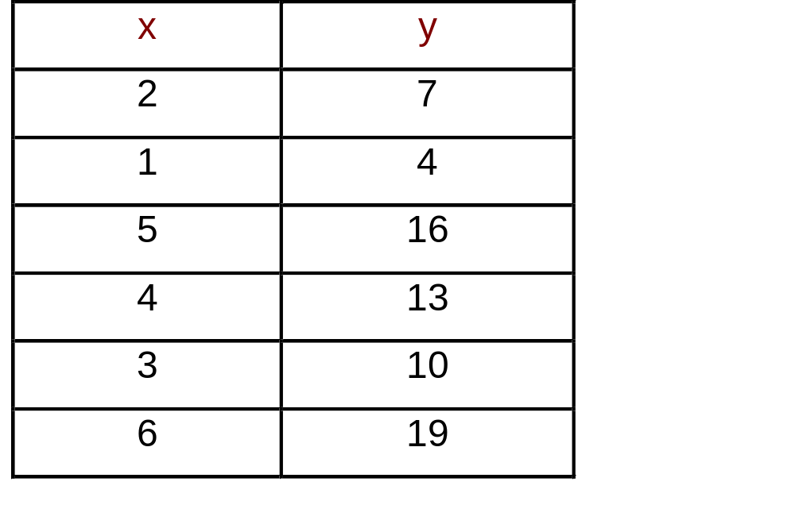
prismo.ai
REGRESSION ANALYSIS
Simple Linear Regression Illustration
Output variable is modeled in terms of only one variable
Regression Model
y = 1 + 3x

Slide 26
prismo.ai
REGRESSION ANALYSIS
Simple Linear Regression
General Form:
y= a + bx +ε
where
a: intercept (the value of y when x is equal to 0)
b: slope (indicates the amount of change in y with every unit change in x)

Slide 27
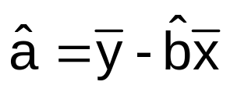
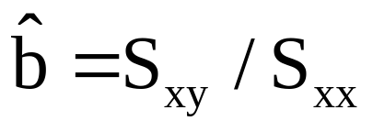
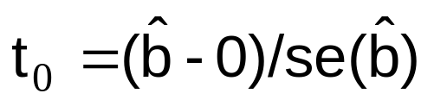
prismo.ai
REGRESSION ANALYSIS
Simple Linear Regression: Parameter Estimation
Model: y = a + bx + ε
Test for Significance (Testing b = 0 or not) of relation between x & y
H0: b = 0
H1: b ≠ 0
Test Statistic
If p value < 0.05, then H0 is rejected & y can be modeled with x

Slide 28
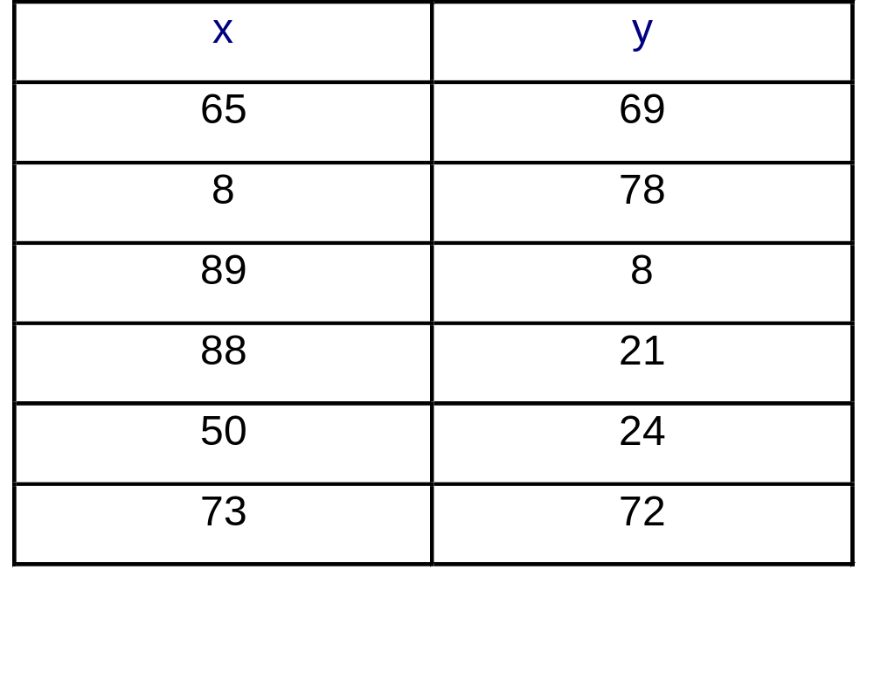
prismo.ai
REGRESSION ANALYSIS
Regression illustration: Example

Slide 29
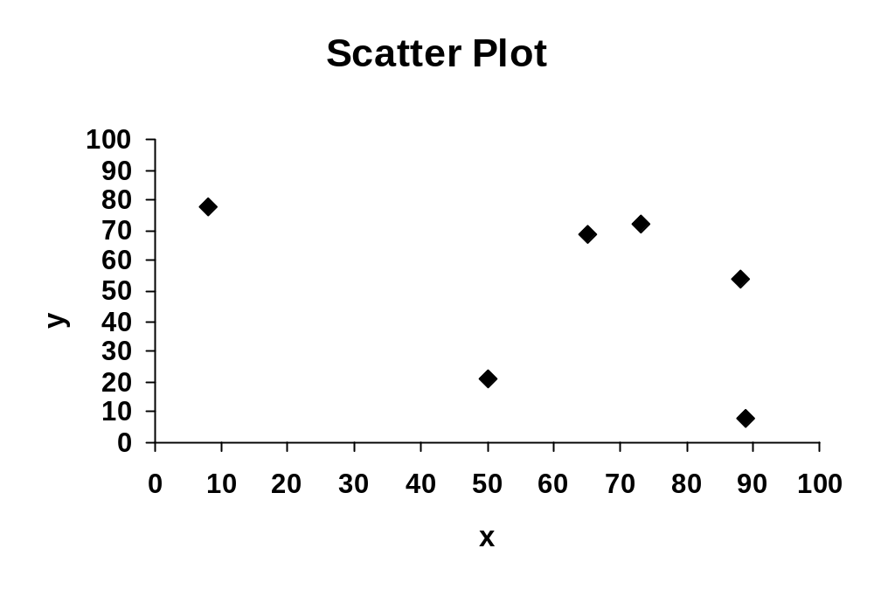
prismo.ai
REGRESSION ANALYSIS
Regression Model y = 76.32 - 0.42x + ε

Slide 30
prismo.ai
REGRESSION ANALYSIS
Regression: Issues
For any set of data,
a & b can be calculated
Regression model y = a + bx + ε can be build
But all the models may not be useful

Slide 31
prismo.ai
REGRESSION ANALYSIS
Coefficient of Regression: Measure of degree of Relationship
Symbol : R²
R² = SS_{R}/ Syy = b.Sxy/ Syy
SS_{R} = Σ(y_{predicted} - Mean y)²
Syy = Σ(y_{actual} - Mean y)²
R² : amount variation in y explained by x
Range of R² : 0 to 1
If R² ≥ 0.6, the Model is reasonably good

Slide 32
prismo.ai
REGRESSION ANALYSIS
Coefficient of Regression: Testing the significance of Regression
Regression ANOVA
Model | SS | df | MS | F | p value
Regression | SS_{R}
Residual | Syy – SS_{R}
Total | Syy
If p value < 0.05, then the regression model is significant

Slide 33
prismo.ai
REGRESSION ANALYSIS
Multiple Linear Regression
To model output variable y in terms of two or more variables.
General Form:
y = a + b₁x₁ + b₂x₂ + - - - + b_{k}x_{k} + ε
Two variable case:
y = a + b₁x₁ + b₂x₂ + ε
Where
a: intercept (the predicted value of y when all x’s are zero)
b_{j}: slope (the amount change in y for unit change in x_{j} keeping all other x’s constant, j = 1,2,---,k)

Slide 34
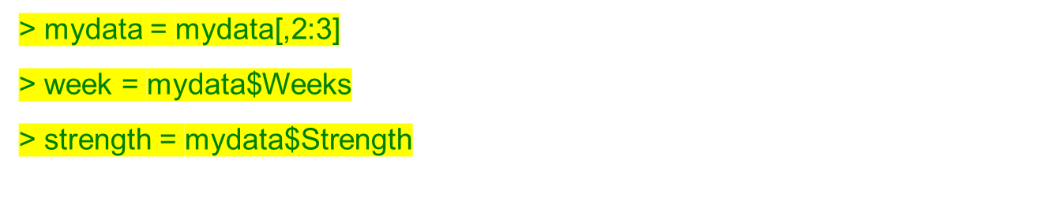
prismo.ai
REGRESSION ANALYSIS
Exercise : The data on the strength of a connector and the age in weeks of the glue used to bond the components of the connector is given in strength file. Develop a model to forecast the strength of the connector using the age of the glue?
Step 1: Read data

Slide 35
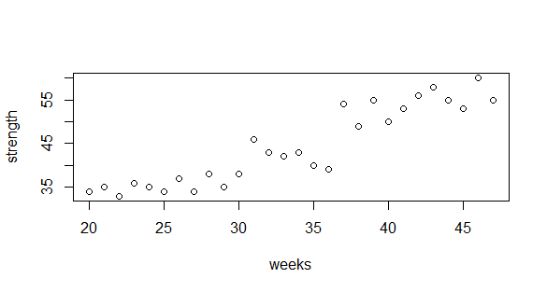
prismo.ai
REGRESSION ANALYSIS
Exercise : The effect of temperature and reaction time affects the % yield. The data collected in given in the Mult-Reg_Yield file. Develop a model for % yield in terms of temperature and time?
Correlation between xs & y should be high
Correlation between xs should be low

Slide 36
prismo.ai
REGRESSION ANALYSIS
Exercise : The effect of temperature and reaction time affects the % yield. The data collected in given in the Mult-Reg_Yield file. Develop a model for % yield in terms of temperature and time?
 | Weeks | Strength
Weeks | 1.000 | 0.925
Strength | 0.925 | 1.000
Correlation between xs & y should be high
Correlation between xs should be low

Slide 37
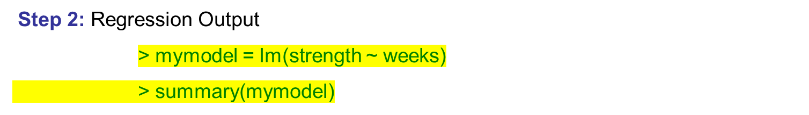
prismo.ai
REGRESSION ANALYSIS
Statistic | Value | Criteria
R Square | 0.8557 | ≥ 0.6
Adjusted R Square | 0.8502 | ≥ 0.6

Slide 38
prismo.ai
REGRESSION ANALYSIS
Regression ANOVA
Model | SS | df | MS | F | p value
Regression | 1865.198 | 1 | 1865.198 | 154.2 | 0.0000
Residual | 314.5167 | 26 | 12.0968
Total | 2179.714 | 27
Criteria: P value < 0.05

Slide 39
prismo.ai
REGRESSION ANALYSIS
Step 2: Regression Output – Identify the model
 | Coefficients | Standard Error | t Stat | P-value
Intercept | 10.43733 | 2.804030366 | 3.72226 | 0.00096
Weeks | 1.01040 | 0.081370297 | 12.4173 | 0.0000
Remark: the p value of significant factor should be < 0.05
Model
Strength = 10.43733 + 1.0104 x Weeks

Slide 40
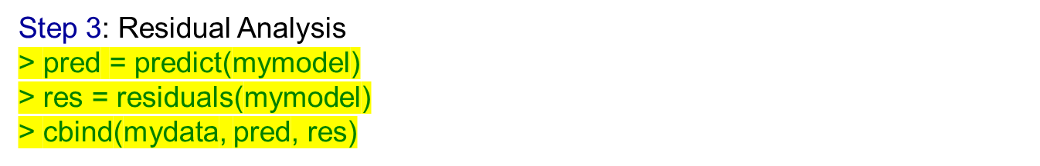
prismo.ai
REGRESSION ANALYSIS
Weeks | Strength | Predicted | Residuals | Weeks | Strength | Predicted | Residuals
20 | 34 | 30.64532 | 3.35468 | 34 | 43 | 44.79091 | -1.79091
21 | 35 | 31.65572 | 3.34428 | 35 | 40 | 45.80131 | -5.80131
22 | 33 | 32.66612 | 0.333881 | 36 | 39 | 46.81171 | -7.81171
23 | 36 | 33.67652 | 2.323481 | 37 | 54 | 47.82211 | 6.177887
24 | 35 | 34.68692 | 0.313082 | 38 | 49 | 48.83251 | 0.167488
25 | 34 | 35.69732 | -1.69732 | 39 | 55 | 49.84291 | 5.157088
26 | 37 | 36.70772 | 0.292282 | 40 | 50 | 50.85331 | -0.85331
27 | 34 | 37.71812 | -3.71812 | 41 | 53 | 51.86371 | 1.136289
28 | 38 | 38.72852 | -0.72852 | 42 | 56 | 52.87411 | 3.125889
29 | 35 | 39.73892 | -4.73892 | 43 | 58 | 53.88451 | 4.11549
30 | 38 | 40.74932 | -2.74932 | 44 | 55 | 54.89491 | 0.10509
31 | 46 | 41.75972 | 4.240285 | 45 | 53 | 55.90531 | -2.90531
32 | 43 | 42.77011 | 0.229885 | 46 | 60 | 56.91571 | 3.084291
33 | 42 | 43.78051 | -1.78051 | 47 | 55 | 57.92611 | -2.92611

Slide 41
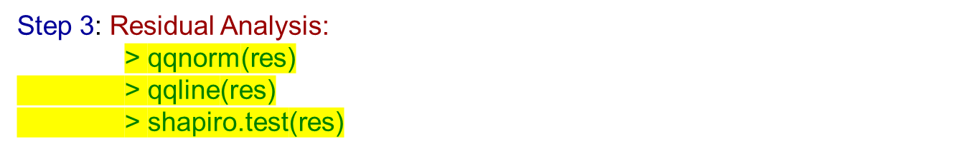
prismo.ai
REGRESSION ANALYSIS
Shapiro-Wilk normality Test: Yield data
W | p value
0.98041 | 0.8601
> mad = mean(abs(res))
> mse = mean(res^2)
> rmse = sqrt(mse)
> mape = mean(abs(res)/strength)
Statistic | Value
MAD | 2.678669
MSE | 11.23274
RMSE | 3.351528
MAPE | 6.20 %

Slide 42
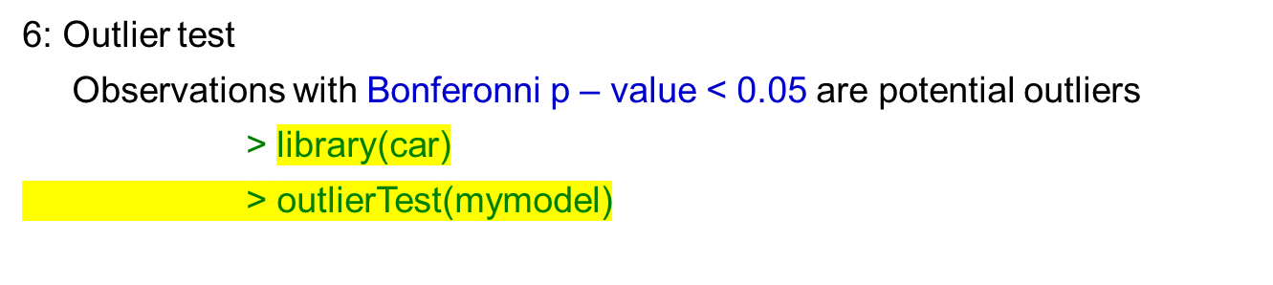
prismo.ai
REGRESSION ANALYSIS
Observation | Studentized Residual | Bonferonni p value
17 | -2.515017 | 0.52363

Slide 43
prismo.ai
Thank You

